Slide 1
Homelessness in America
Regis University
MSDS696 – Data Science Practicum II
Instructor John Koenig
Ashley Mimaki
Notes:
Hi my name is Ashley Mimaki and I am presenting my Data Science Practicum Project on Homelessness in America

Slide 2
Contents
Situation
Research Question
Data
Methodology
Resources
Results
Conclusions

Slide 3
Research Problem
Homelessness in America
Illicit Drug Use
Mental Health
Notes:
As you can gather from the title slide the over arching research problem I am looking at is people experiencing homelessness and related factors that I will be talking about are illicit drug use and mental health in terms of mental illness prevalence and treatment at a state level.

Slide 4
Research Questions
What factors affect a state’s homeless population?
Can certain factors, data points, of a state be used to predict the homeless population of a state?
Could addressing these factors help tackle the problem of homelessness?
Notes:
The research questions I pose are what factors affect a state’s homeless population?
My primary focus on this project was looking at mental health and drug use which previous research has shown that they have a complicated two way relationship with homelessness
And then I ask if these factors can be used to predict a state’s population that this experiencing homelessness and if address these factors will help tackle the problem

Slide 5
Data
Data from the Substance Abuse and Mental Health Services Administration that contains illicit drug use
Data from the US Department of Housing and Urban Development that contain homelessness population and shelters available year round
State’s populations
Data from Mental Health America that ranks states mental illness prevalence as well as availability and ability to provide treatment
Notes:
I gathered my data from four different resources, the substance abuse and mental health services administration, the US dept of housing and urban development, the us census, and mental health America.
I ended up with a total of 5 data sets that I combined into a single data frame with a total of 33 columns of different factors.

Slide 6
Methodology
Clean data – look for any missing or unneeded data and create a single dataframe
Perform exploratory data analysis
Find any correlations between a state’s homeless population and the other factors in my data
Using machine learning find if a homeless population % is predictable for a state
Observe the weight of which factors contribute to the prediction.
Notes:
Here you can take a look at my methodology as I mentioned in my previous slide the first step was to collect and clean data and then I moved on to exploratory data analysis, creating and finding the best model and observing those predictions.

Slide 7
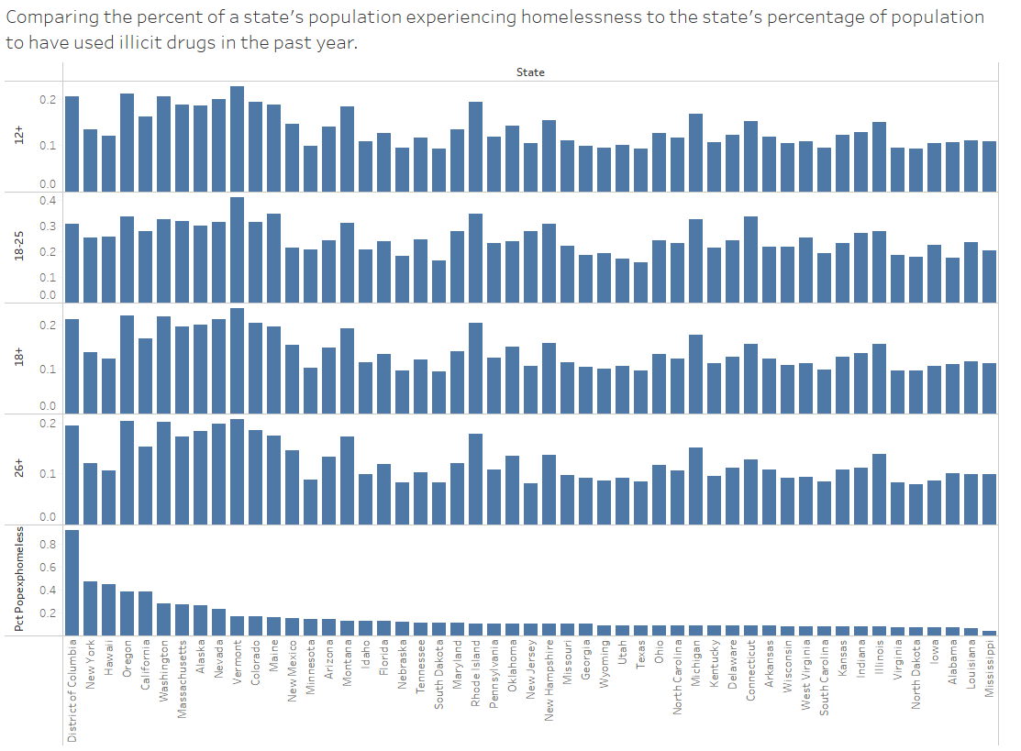
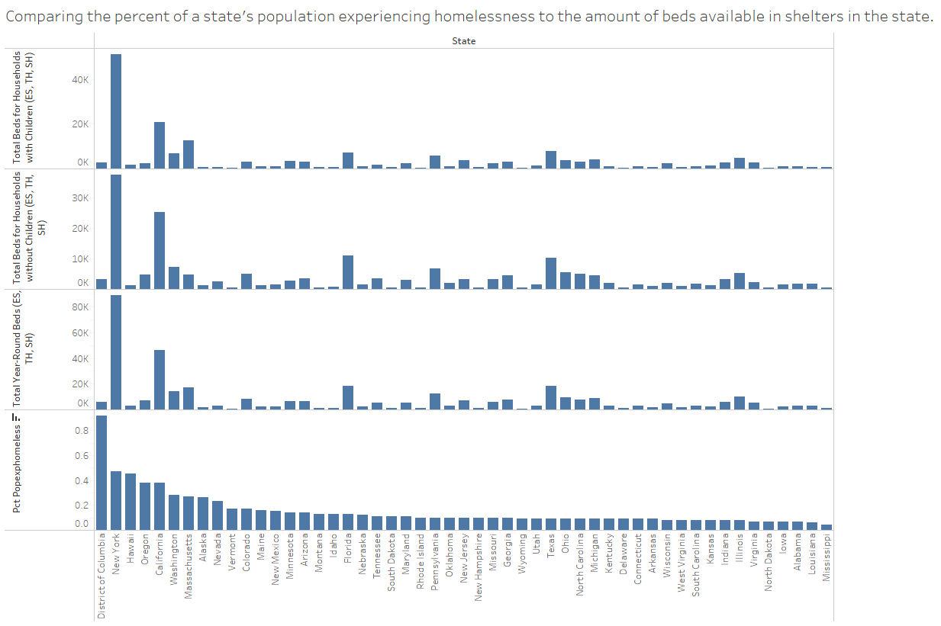
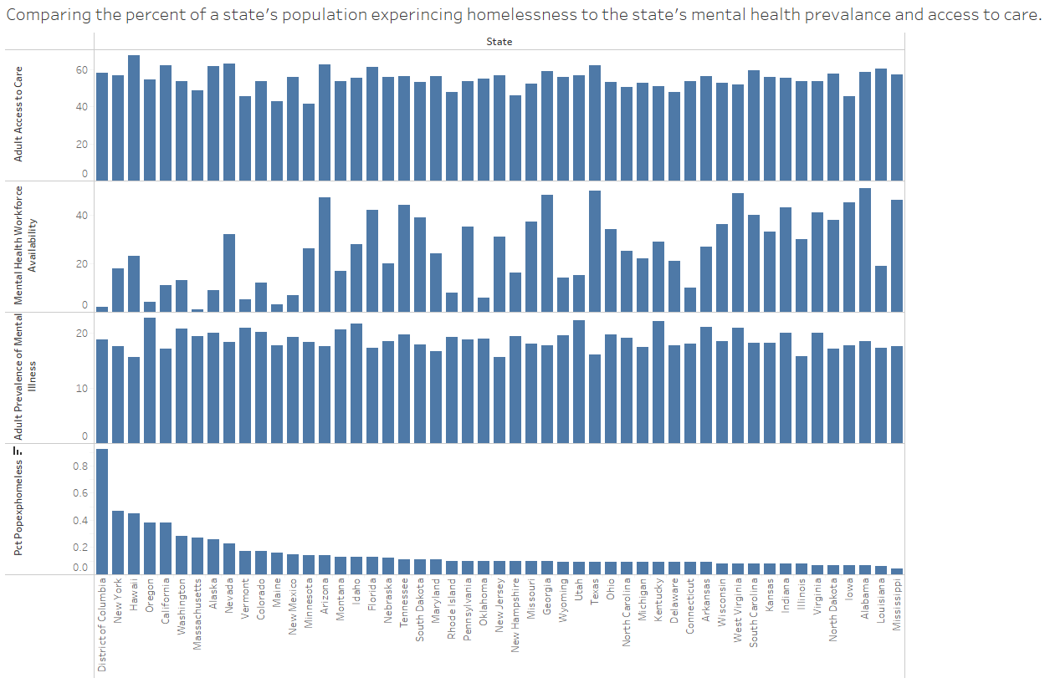
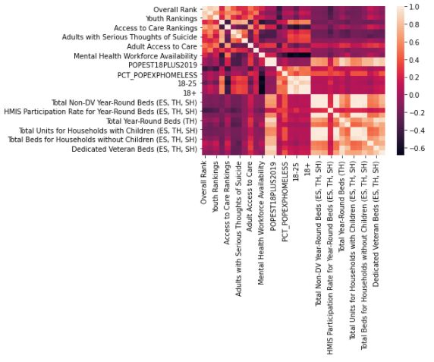
Results: Exploratory Data Analysis
Limited correlations seen in the charts above with homeless %
Drug Use (left)
Beds (center)
Mental Health (right)
Heatmap from Python shown on the right

Slide 8
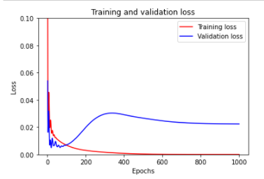
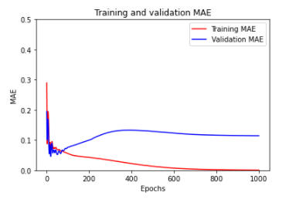
Results: Models
Random Forest Model
MSE for DTReg (All features): 0.01
MAE for DTReg (All features): 0.06
Sequential Neural Network Model
Loss = 0.0112
MAE = 0.0747
Training and Validation Loss and MAE graphs shown on the right

Slide 9

Conclusions
Homelessness is predictable with the correct factors and using a model with a good fit
Prediction models could help a state’s or city’s approach to homelessness by initiating projects that tackle the causes
Could lead to improvements in shelter availability based on other factors in a state or city
Future research looking at a city level would allow for more data points and perhaps a better model and predictions
Future research including new factors like a state’s or city’s average rent prices as well as average income

Slide 10
Resources
2019-2020 National Survey on Drug Use and Health: Model-Based Prevalence Estimates (50 States and the District of Columbia) | CBHSQ Data. (2021, December 29). Substance Abuse and Mental Health Services Administration. https://www.samhsa.gov/data/report/2019-2020-nsduh-state-prevalence-estimates
Frost, J. (2021, April 1). Making Predictions with Regression Analysis. Statistics By Jim. https://statisticsbyjim.com/regression/predictions-regression/
Homelessness Statistics by State, Tools for Action. (2021). Homelessness Statistics by State | United States Interagency Council on Homelessness (USICH). https://www.usich.gov/tools-for-action/map/#fn[]=1300&fn[]=2900&fn[]=6400&fn[]=10200&fn[]=13400
Konkiewicz, M. (2021, December 12). Sorting data frames in pandas - Towards Data Science. Medium. https://towardsdatascience.com/sorting-data-frames-in-pandas-a5a3af6f346a#:%7E:text=Let%E2%80%99%20start%20with%20sorting%20a%20data%20frame%20by,using%20a%20parameter%20called%20%E2%80%98by%E2%80%99%20%3A%20df.sort_values%20%28by%3D%27name%27%29
Low-Income Housing Tax Credit (LIHTC): Tenant Level Data | HUD USER. (2020). U.S. Department of Housing and Urban Development. https://www.huduser.gov/portal/datasets/lihtc/tenant.html
Mental Health America. (2019). The State of Mental Health in America. https://mhanational.org/sites/default/files/2019-09/2019%20MH%20in%20America%20Final.pdf
National Coalition for the Homeless. (2009, July). Mental Illness and Homelessness. https://www.nationalhomeless.org/factsheets/Mental_Illness.pdf
PIT and HIC Data Since 2007. (2022, February). HUD Exchange. https://www.hudexchange.info/resource/3031/pit-and-hic-data-since-2007/
Pramoditha, R. (2021, December 16). Train a regression model using a decision tree - Towards Data Science. Medium. https://towardsdatascience.com/train-a-regression-model-using-a-decision-tree-70012c22bcc1
Tarr, P. (2020, February 3). Homelessness and Mental Illness: A Challenge to Our Society. Brain & Behavior Research Foundation. https://www.bbrfoundation.org/blog/homelessness-and-mental-illness-challenge-our-society

